Slide 1

Search A*
Members:
Cáceres Díaz, Renzo (11200004)
Escobar Villa, Andrés David (6200075)
Gonzales Aburto, Ricardo Daniel (18200061)
Huamaní Avendaño, Dulce María (18200219)
Molina Yupanqui, Flor Giannina (18200164)
Palomino Loa, Junior (18200172)
Quispe Vega, Anthony Yair (18200179)
Vera León, Bryan (18200124)

Slide 2
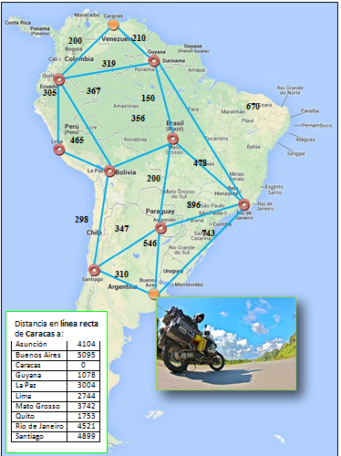
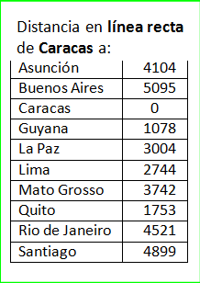
Search A*

Slide 3
Search A*
Minimize the total estimated cost of the function. Evaluates nodes by combining G(n) and H(n). Where: H(n): Travel costs to get from Buenos Aires to the city "n". G(n): Distance in a straight line measured in km to get from Buenos Aires to the city "n". Heuristics: F(n) = G(n) + H(n) : Cheapest estimated cost of the solution via "n"; consuming less money and at the same time traveling less distance in each journey until reaching the destination.

Slide 4
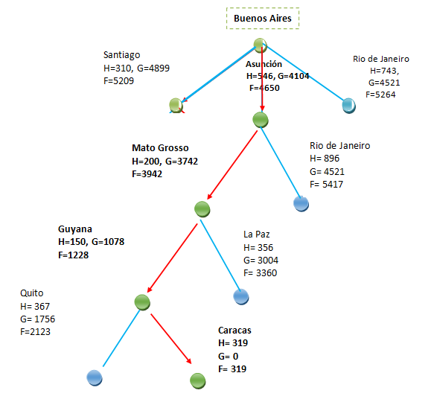
Search A*

Slide 5
Search A*
The route I would take would be: Buenos Aires – Asunción – Mato Grosso – Guyana – Caracas Total cost: (546 + 200 + 150 + 319) = 1215

